Slide 1
CARDIAC CYCLE
DR VIVEK C WARRIER
SENIOR RESIDENT
DEPARTMENT OF CARDIOLOGY ,GMC CALICUT

Slide 3
cardiac cycle describes a series of pressure changes that take place within the heart resulting in the movement of blood through different chambers of the heart
These pressure changes originate as conductive electrochemical changes within the myocardium that result in the concentric contraction of cardiac muscle.
A single cycle of cardiac activity can be divided into two basic phases - diastole and systole.

Slide 4
ELECTRICAL EVENTS MECHANICAL EVENTS

Slide 7
Cardiac Impulse Transmission
Initiated by spontaneous generation of AP in SA node
travel to AV node (1m/s) in 0.03 sec.
total delay in the A-V nodal and A-V bundle system is about 0.13 sec
AV nodal Delay allows time for the atria to empty their blood into the ventricles before ventricular contraction begins
Rapid Transmission in the Purkinje System(1.5 to 4.0 m/sec)…almost instantaneous transmission of the cardiac impulse throughout the ventricular muscle

Slide 9
Mechanical events

Slide 10
Physiologic Versus Cardiologic Systole and Diastole
cardiologic systole is demarcated by heart
sounds rather than by physiologic events & starts
fractionally later than physiologic systole and
ends significantly later.
cardiologic systole - between closure of mitral valve and opening of aortic valve
Physiologic systole – isovolumetric contraction ,rapid ejection

Slide 11
PHASES OF CARDIAC CYCLE
Atrial contraction
Isovolumetric contraction
Rapid ejection
Slow ejection
Isovolumetric relaxation
Rapid filling
Slow filling

Slide 12
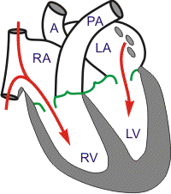
ATRIAL CONTRACTION
It is initiated by the P wave of the electrocardiogram, which represents electrical depolarization of the atria.
As the atria contract, the pressure within the atrial chambers increases, which forces more blood flow across the open atrioventricular (AV) valves, leading to a rapid flow of blood into the ventricles.

Slide 13
Blood does not flow back into the vena cava because of inertial effects of the venous return and because the wave of contraction through the atria moves toward the AV valve thereby having a "milking effect."
Atrial contraction does produce a small increase in venous pressure that can be noted as the "a-wave" of the left atrial pressure.
Atrial contraction normally accounts for about 10-20% of left ventricular filling when a person is at rest
At high heart rates when there is less time for passive ventricular filling, the atrial contraction may account for up to 40% of ventricular filling. This is sometimes referred to as the "atrial kick."

Slide 14
After atrial contraction is complete, pressure begins to fall; at this time, the ventricular volumes are maximal, which is termed the end-diastolic volume (EDV) about 120ml (pre load)
End-diastolic pressures - 8-12 mmHg (LV) & 3-6 mmHg (RV)
fourth heart sound S₄

Slide 15
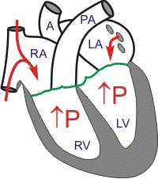
ISOVOLUMETRIC CONTRACTION
All Valves Closed
Begins with the appearance of the QRS complex of the ECG, which represents ventricular depolarization

Slide 16
The AV valves close when intraventricular pressure exceeds atrial pressure, Closure of the AV valves results in the first heart sound (S1)
During the time period between the closure of the AV valves and the opening of the aortic and pulmonic valves, ventricular pressure rises rapidly without a change in ventricular volume
"c-wave" may be noted in the LAP may be due to bulging of mitral valve leaflets back into left atrium.

Slide 17
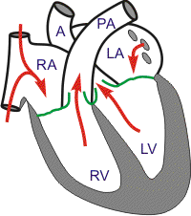
RAPID EJECTION
Aortic and Pulmonic Valves Open; AV Valves Remain Closed
Ejection begins when the intraventricular pressures exceed the pressures within the aorta and pulmonary artery, which causes the aortic and pulmonic valves to open.

Slide 18
No heart sounds are ordinarily noted during ejection because the opening of healthy valves is silent.
Left atrial pressure initially decreases as the atrial base is pulled downward, expanding the atrial chamber. Blood continues to flow into the atria from their respective venous inflow tracts and the atrial pressures begin to rise. This rise in pressure continues until the AV valves open

Slide 19
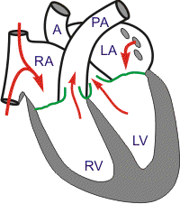
REDUCED EJECTION
Approximately 200 msec after the QRS, ventricular repolarization occurs as shown by the T-wave
Repolarization leads to a decline in ventricular active tension and pressure generation; therefore, the rate of ejection (ventricular emptying) falls. Ventricular pressure falls slightly below outflow tract pressure; however, outward flow still occurs due to kinetic energy of the blood & elastic recoil of aorta ( windkessel effect)
Left atrial and right atrial pressures gradually rise due to continued venous return from the lungs and from the systemic circulation, respectively.

Slide 20
ISOVOLUMETRIC RELAXATION
When the intraventricular pressures fall sufficiently at the end of phase 4, the aortic and pulmonic valves abruptly close (aortic precedes pulmonic) causing the second heart sound (S2)
Valve closure is associated with a small backflow of blood into the ventricles and a characteristic notch (incisura or dicrotic notch) in the aortic and pulmonary artery pressure tracings.

Slide 21
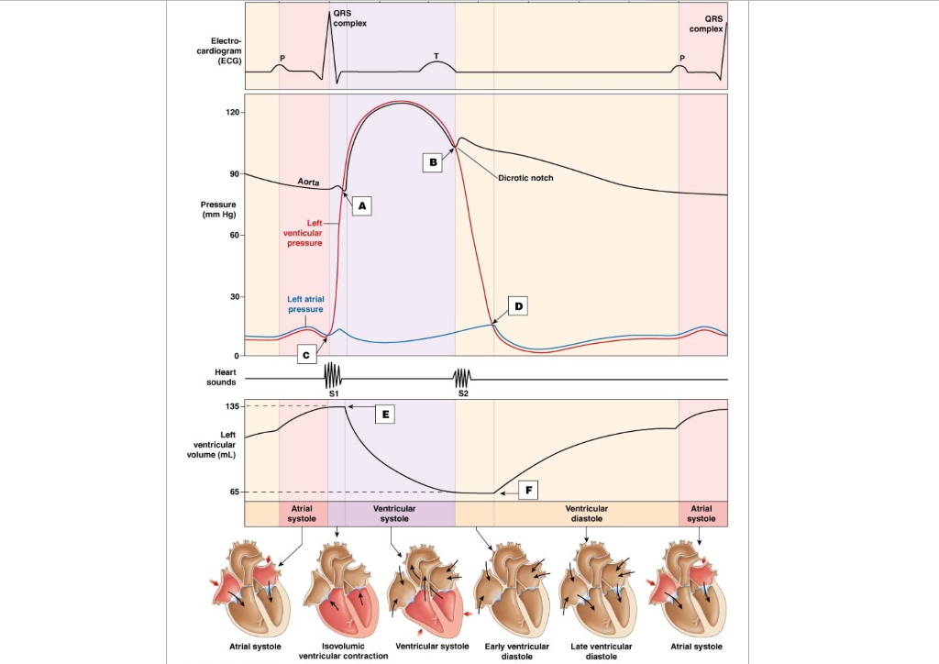
After valve closure, the aortic and pulmonary artery pressures rise slightly (dicrotic wave) following by a slow decline in pressure.

Slide 22
Although ventricular pressures decrease during this phase, volumes do not change because all valves are closed.
The volume of blood that remains in a ventricle is called the end-systolic volume and is ~50 ml in the left ventricle.
The difference between the end-diastolic volume and the end-systolic volume is ~70 ml and represents the stroke volume.
Left atrial pressure (LAP) continues to rise because of venous return from the lungs. The peak LAP at the end of this phase is termed the v-wave.

Slide 23
RAPID FILLING
Ventricles continue to relax at the end of phase 5, the intraventricular pressures will fall below their respective atrial pressures.
When this occurs, the AV valves rapidly open and passive ventricular filling begins.
Despite the inflow of blood from the atria, intraventricular pressure continues to briefly fall because the ventricles are still undergoing relaxation.

Slide 24
Once the ventricles are completely relaxed, their pressures will slowly rise as they fill with blood from the atria.
The peak of the LAP just before the valve opens is the "v-wave." This is followed by the y-descent of the LAP.
Ventricular filling is normally silent. When a third heart sound (S3) is audible during rapid ventricular filling, it may represent tensing of chordae tendineae and AV ring during ventricular relaxation and filling.
This heart sound is normal in children; but is often pathological in adults and caused by ventricular dilation

Slide 25
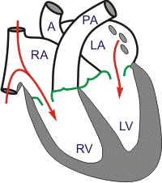
REDUCED FILLING
As the ventricles continue to fill with blood and expand, they become less compliant and the intraventricular pressures rise. The increase in intraventricular pressure reduces the pressure gradient across the AV valves so that the rate of filling falls late in diastole.
In normal, resting hearts, the ventricle is about 80- 90% filled by the end of this phase.
Aortic and pulmonary arterial pressures continue to fall during this period.

Slide 26
Total ventricular systole 0.3 sec
Isovolumic contraction (b) 0.05 sec (0.015sec for RV)
Maximal ejection (c) 0.1 sec
Reduced ejection (d) 0.15 sec
Total ventricular diastole 0.5 sec
Isovolumic relaxation (e) 0.1 sec
Rapid filling phase (f) 0.1 sec
Slow filling (diastasis) (g) 0.2 sec
Atrial systole or booster (a) 0.1 sec
GRAND TOTAL (Syst+Diast) = 0.8 sec

Slide 27
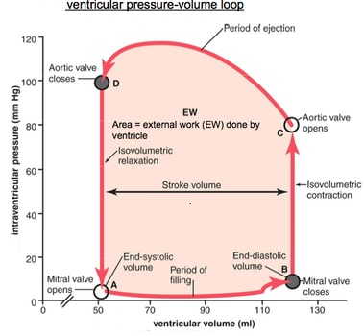
PRESSURE VOLUME LOOP
Pressure-volume loop of RV is same as that of LV, however the area is only 1/5th of LV because pressures are so much lower on right

Slide 28
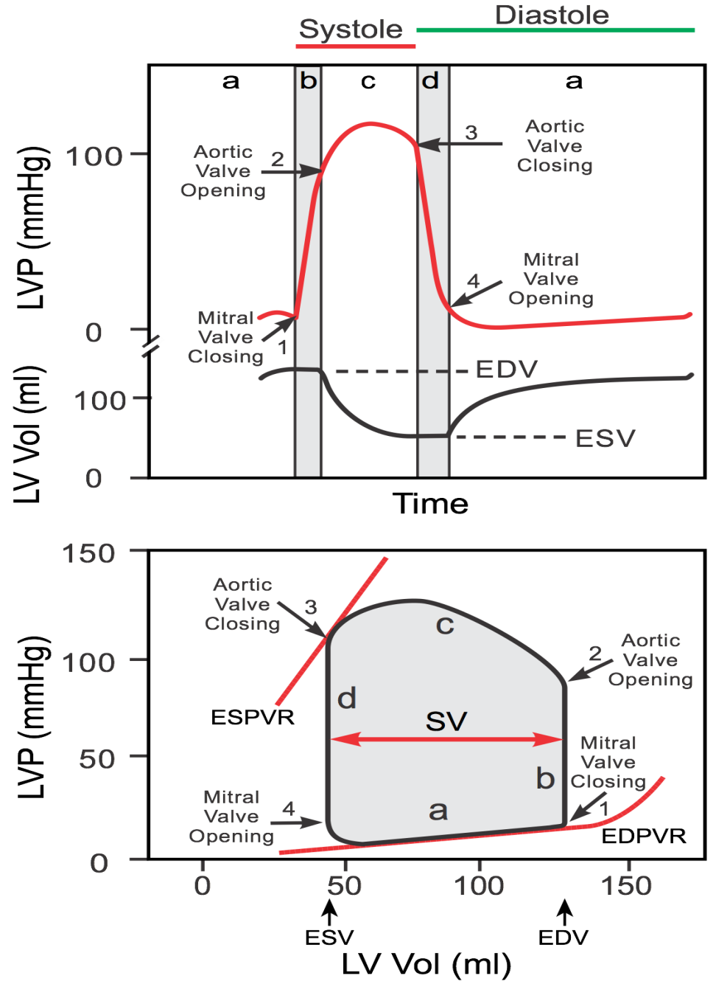
The maximal pressure that can be developed by the ventricle at any given left ventricular volume is defined by the end-systolic presuure-volume relationship (ESPVR), which represents the inotropic state of the ventricle
Ventricular filling occurs along the end-diastolic pressure-volume relationship (EDPVR), or passive filling curve for the ventricle. The slope of the EDPVR is the reciprocal of ventricular compliance

Slide 29
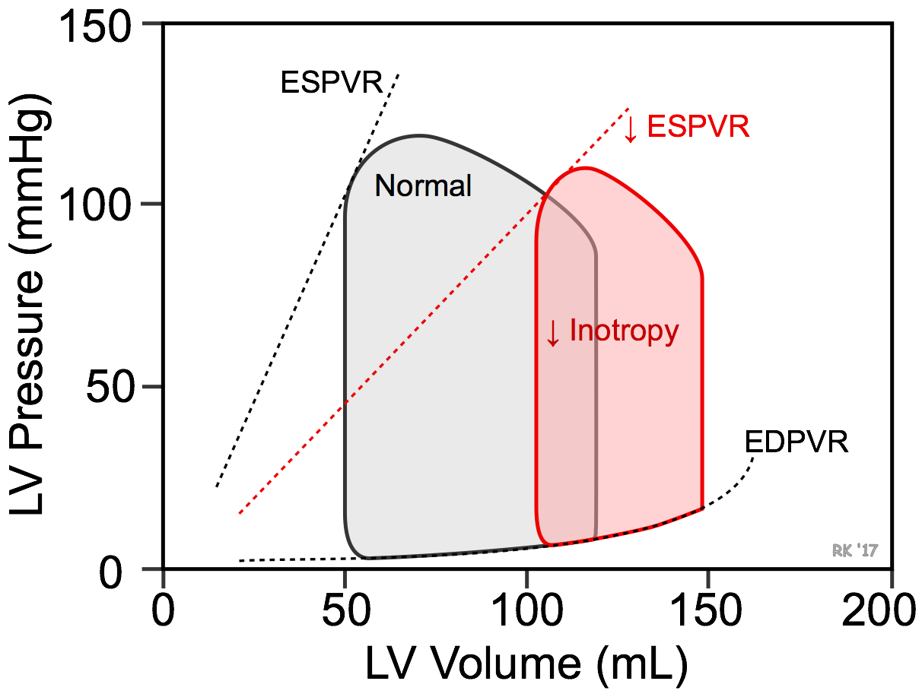
Loss of intrinsic inotropy decreases the slope of the end-systolic pressure-volume relationship (ESPVR)
This leads to an increase in end-systolic volume (red loop)
There is also an increase in end-diastolic volume (compensatory increase in preload), but this increase is not as great as the increase in end-systolic volume
Therefore, the net effect is a decrease in stroke volume

Slide 30
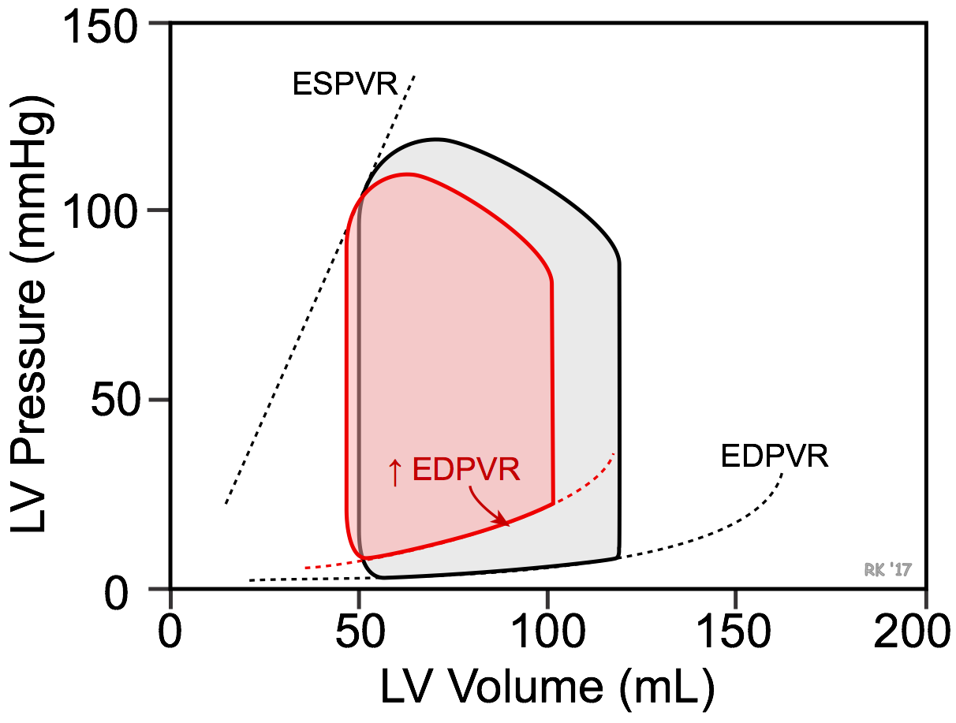
A reduction in ventricular compliance, as occurs in ventricular hypertrophy, increases the slope of the ventricular end-diastolic pressure-volume relationship (EDPVR) & results in less ventricular filling (decreased end-diastolic volume) & a greater end-diastolic pressure

Slide 31
Rt ventricular
Pressure wave 1/5th
dp/dt is less
Isovolumetric contraction & relaxation phases are short

Slide 32
TIMING OF CARDIAC EVENTS
RA start contracting before LA
LV start contracting before RV
TV open before MV, so RV filling start before LV
RV peak pressure 1/5th of LV
RV outflow velocity smooth rise & fall, while Lt side initial peak followed by quick fall

Slide 34
SYSTOLIC TIME INTERVALS

Slide 35
Non-invasive cardiology did not begin with ultrasound but rather as investigations into systolic time.
Studies in 1875 by Garrod showed that the Left Ventricular Ejection Time [LVET] – the time that the aortic valve is open & ejecting blood – varies inversely with heart rate.
In 1904, Bowen used carotid pulse tracing to measure LVET in man.
In 1923, Katz & Feil deconstructed systole into sub-components using ECG, phonocardiogram & pulse of a central artery such as the common carotid artery.

Slide 36
Systole has 2 distinct time periods – the pre-ejection period [PEP] & the LVET.
PEP is defined as the time between the onset of electrocardiographic systole & the opening of aortic valve.
LVET begins with the aortic valve opening & terminates at its closure – marked by the onset of S2, or the dicrotic notch in the pulse tracing of a central artery.

Slide 37
QS2 (Electromechanical systole) – PEP + LVET
QS2 is constant over a wide variety of cardiac disorders.
Clinical importance : Increased inotropic state is reflected by a decrease in QS2, & a decreased inotropic state prolongs QS2.

Slide 40
PEP begins with electrical systole and ends when the aortic valve opens.
The opening of the aortic valve has been defined as the upstroke in the pulse waveform of common carotid artery.
There is a small delay between the upstroke of pressure in the central aorta and the common carotid by 18-20 milliseconds.
PEP may be defined by relating the onset of systole on ECG to both M-mode of aortic valve as well as Doppler of aortic outflow tract & carotid artery.

Slide 41
PEP reflects the time the ventricle is in isovolumic contraction.
PEP is prolonged when myocardial contractility is impaired.
PEP also rises when stroke volume falls acutely.
LVET shows a direct relationship with stroke volume.

Slide 42
PEP/LVET ratio – Measure of LV ejection fraction
Normally, PEP = 1/3rd of LVET
When PEP> 45%, likelihood increase in LVET is <40-45%
corrected Systolic Flow Time [ cSFT ] is LVET corrected for heart rate

Slide 45
THANK YOU

